Slide 1


Course : Machine Learning II (DAB-300) Instructor : Prof. Sara Hamad

Slide 2
Project CONTRIBUTORS
AAYUSH VAISHNAV (0805055)
PARTH JOSHI (0805440)
Dharmkumar kakadiya
(0785327)
JUNED SALEH
(0805065)
DEEV VIRADIYA
(0805400)

Slide 3
Real-Time FaceMask Detection

Slide 4

Contents
Introduction,
Pillars of Project,
Model Architecture and Training,
Accuracy,
Plot Chart,
Implementation,
Questions,
System requirements,
Installation.

Slide 5
INTRODUCTION
In recent times, where Covid-19 has impacted a domino effect on manufacturing, travel, tourism, hospitality, crippling the global economy. In addition to it, is the growing curve of human deaths across the globe due to the pandemic, this project which relies on computer vision and deep learning, intends to make an impact and solve the real-world problem of safety measures at some significant level.
This project can be used at airports, offices, hospitals and many more public places to ensure that the safety standards are maintained, and people are abiding by the rules and regulations to wear protective masks at public places. If the detection system classifies as ‘No Mask’, reminders can be given as well as actions can be taken against such individuals.
The objective of this study is to develop a Face Mask Detection system using OpenCV, Keras/TensorFlow, and Deep Learning in order to detect face masks in static images as well as live video streams.

Slide 6
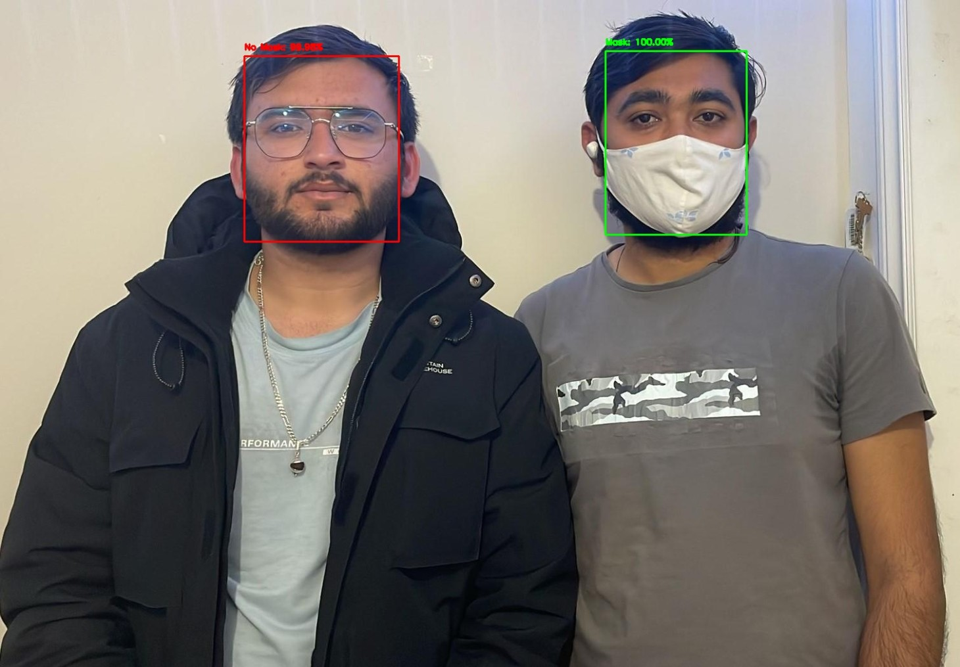
FACEMASK DETECTION
Real-Time Implementation of AI-Based Facemask Detection

Slide 7
Pillars of Project
Model ARCHITECTURE
Model ACCURACY
Mask DETECTION
Multiple IMPLEMENTATIONS
FACEMASK DETECTION

Slide 8
Model Architecture & Training
Phase #1: Train Face Mask Detector
Load Facemask Dataset
Train facemask classifier with Keras/TensorFlow
Serialize facemask classifier to disk
Phase #2: Apply Face Mask Detector
Load Facemask classifier from disk
Detect faces in images/video stream
Extract each face ROI
Show Result
Apply facemask classifier to each face ROI to determine “mask” or “no mask”
Architecture

Slide 9
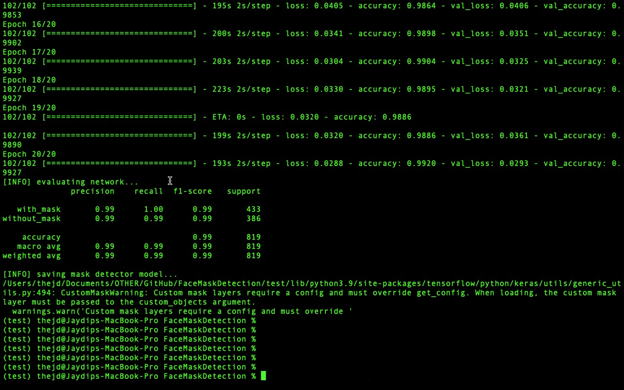
Accuracy

Slide 10
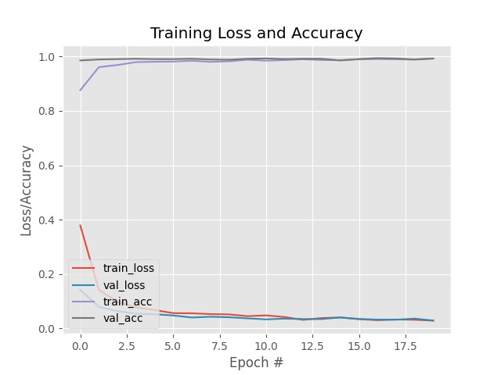
Plot chart

Slide 11
Implementation
Command Line
Browser
Hardware

Slide 12

DEMONSTRATION

Slide 13
INSTRUCTOR’S CRAZY QUESTIONS -1
How did you maintain more than 99% accuracy with real time streaming?

Slide 14
INSTRUCTOR’S CRAZY QUESTIONS-2
Is it possible to feed the image via browser rather then command line? because it is a slightly tedious task for non-technical person?

Slide 15
INSTRUCTOR’S CRAZY QUESTIONS-3
Is it possible to embed camera from browser itself? Because user is too lazy that he doesn’t wants to even feed the image.

Slide 16
INSTRUCTOR’S CRAZY QUESTIONS-4
Is it possible to do real time video streaming? Because user wants to seat on his couch and wants to check weather, he is wearing mask or not?

Slide 17
INSTRUCTOR’S CRAZY QUESTIONS-5
Is it possible to deploy all of this ghost code into some actual hardware?

Slide 18
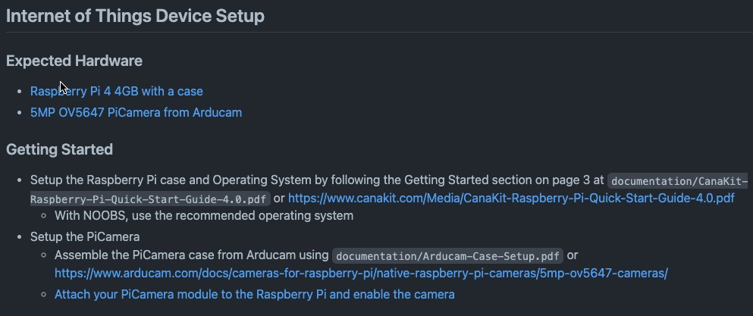
Hardware Implementation

Slide 19
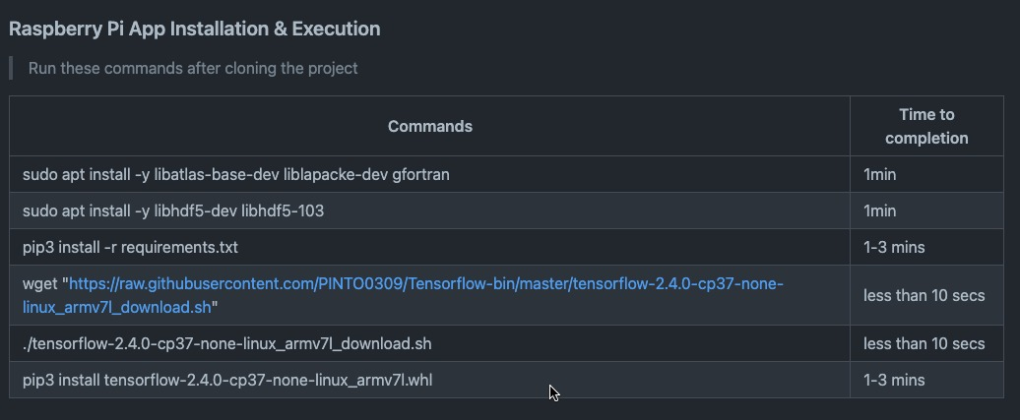
Install & Execute

